Slide 1
Trans-Atlantic Slave Trade
African-American History
(TidyTuesday dataset from 06/16/20)

Slide 2
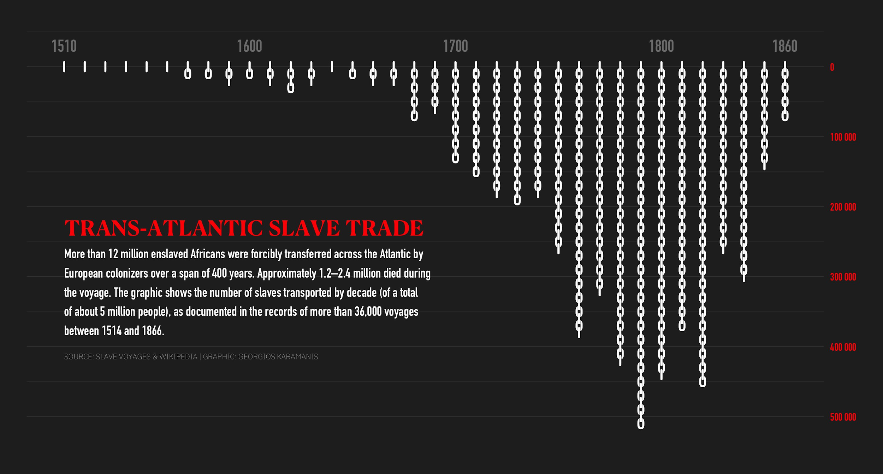
#TidyTuesday Dataset: Trans-Atlantic Slave Trade
Georgios Karamanis @geokaramanis https://twitter.com/geokaramanis/status/1273663628315680772
Notes:
We chose to do a tidy tuesday presentation on the trans-Atlantic slave trade because history books have taught us one thing but the numbers could tell us other pieces of information that may be hidden. This graphic displays the number of slaves per time period in a histogram-like format..(then go into what x-axis, y-axis, design elements)

Slide 3
Dataset Overview
“Slave Routes dataset shows number of slaves transported by decade (36k total records)
Columns include:
Voyage ID (num), Ship Name (chr) , Port of Origin (chr), Place of Purchase (chr), Port of Arrival (chr), Year of Arrival (num), Number of Slaves that Arrived (num), Captain’s Name (chr)

Slide 4

Demo!

Slide 5
Thank you!
Any questions?

